Slide 1
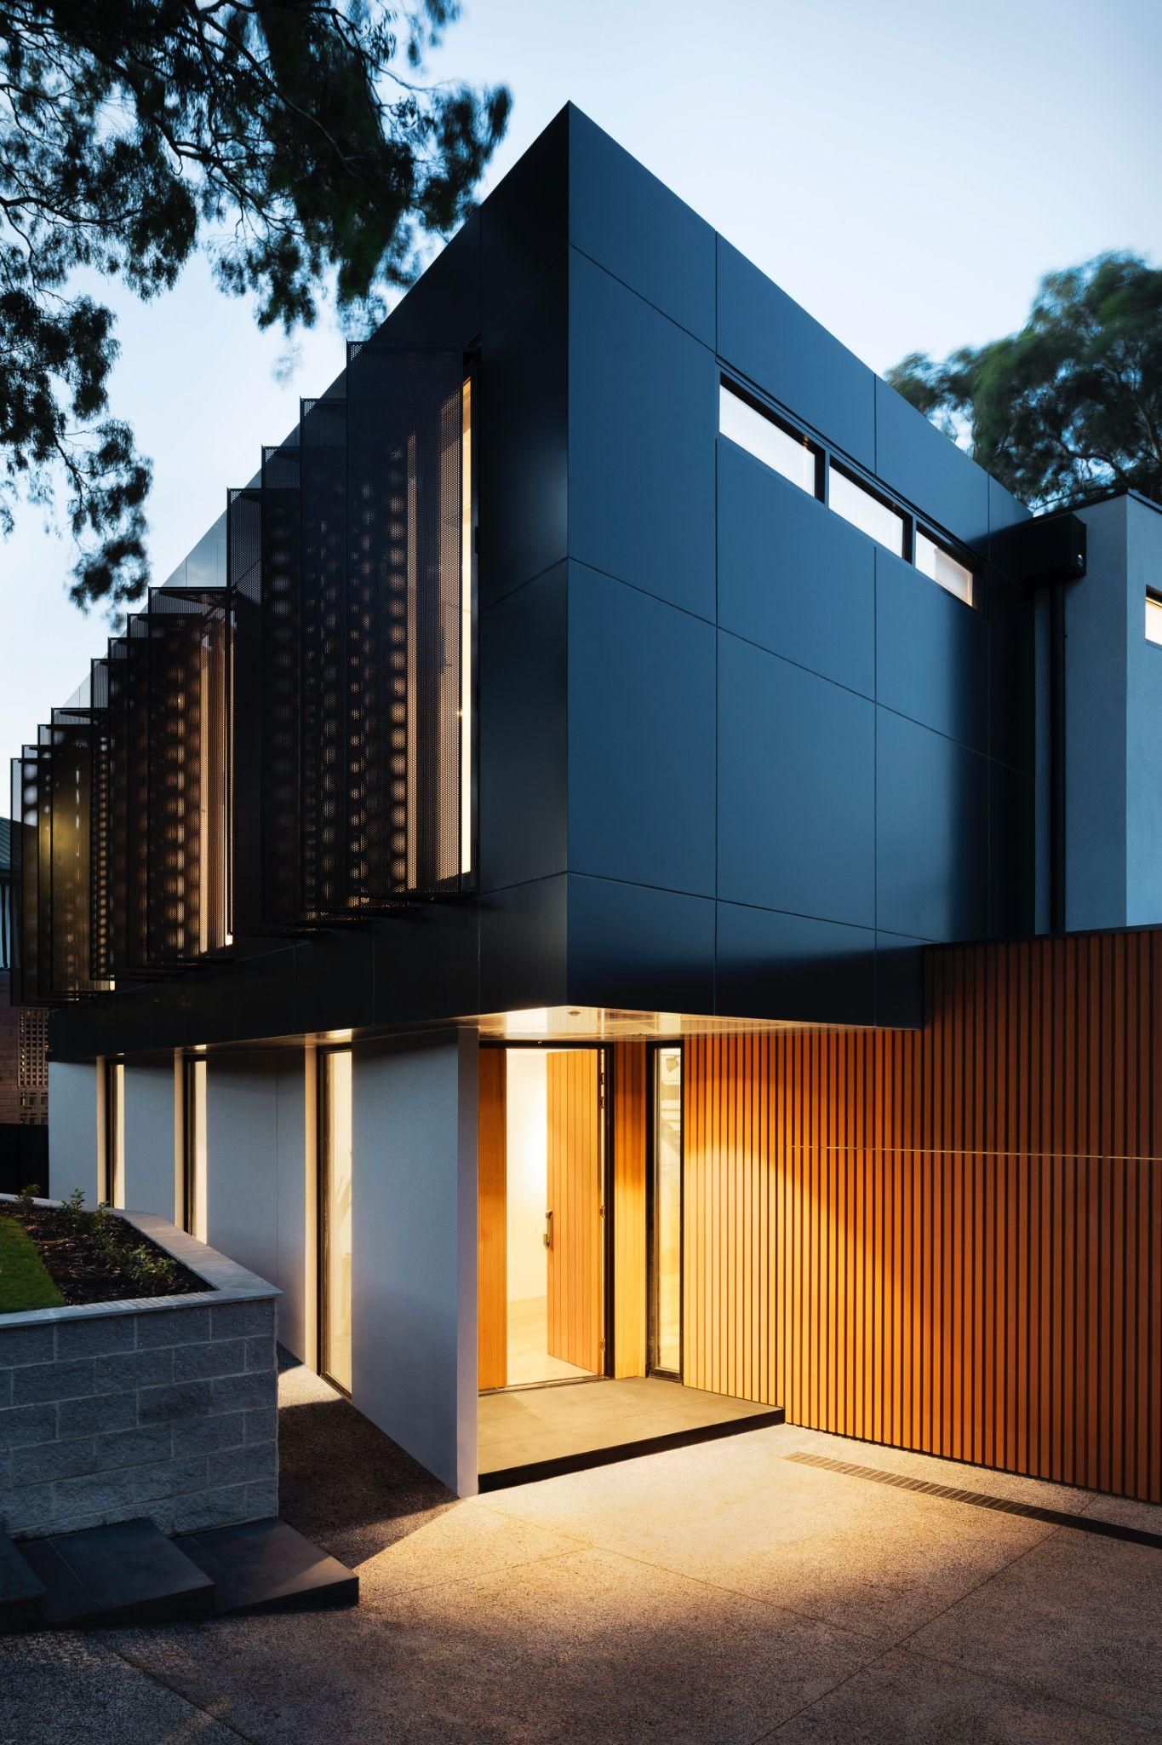
NEST 04
Project Nr04
NEST data-driven building
Jerry Overton, Logan Wilt, Martin Horeni, Wolfram Willuhn, Gonzalo Casas, Benjamin Huber, Philipp Heer

Slide 2
NEST 04
The Challenge
Manage buildings in ways that are more sustainable and energy efficient
The Idea
Train a machine-learning algorithm to maintain a target temperature

Slide 3

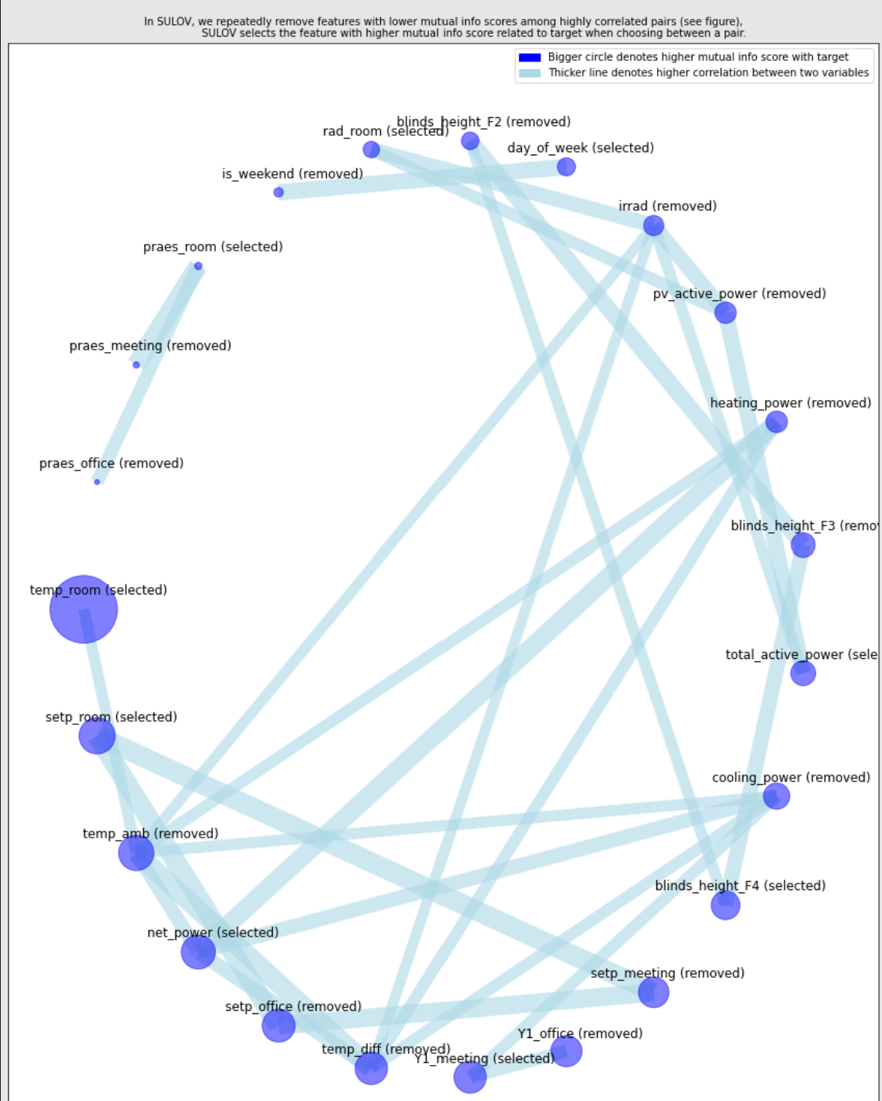
NEST 04
What we did
Used genetic programming to automatically explore thousands of models
The prototype
Best pipeline: XGBRegressor
11 Optimal Features Found
Our results suggest automating the adjustment of windows blinds and power settings to help maintain a target temperature

Slide 4

NEST 04
Resources/Data
NEST Open Building Data
Google Collab
Next Steps
Run with larger data sets
Explore new features
Team:
Jerry Overton, Logan Wilt,
Martin Horeni, Wolfram Willuhn, Gonzalo Casas, Benjamin Huber,
Philipp Heer

